Slide 1
ITEC 102 INTRODUCTION TO INFORMATION SYSTEMS
DANIEL OBUOBI, DCSIT, CU
MODELLING – DFD, FLOWCHART. DECISION TABLES etc

Slide 2
ANALYSIS THROUGH MODELING
Models are representatives of reality.
Used in many different ways and in a variety of forms.
Important aids to thinking and communication and hence very useful the analyst
The selecting of an appropriate model requires
Flexibility
Imagination, and finally
adopting and devising a model appropriate to the circumstances.

Slide 3
OVERVIEW
We consider modeling along the following lines
Modeling Physical Processes
Scribbled diagram / Rich Picture
English Narrative prompts a number of questions, which leads to (2).
Prompts a number of questions about message (Formal/Informal) leading to the Modeling of the message system.
Modeling messages (formal/ informal)
DFD
Flowchart prompts a number of questions about duties and procedures
Modeling Routines and Procedures
Decision Table
Decision Tree
Structured English (If then etc)

Slide 4
USING MODELS
Should reflect the following four principles
Communication not Confusion
Should be completely understood by the recipients. Simple
Appropriate accuracy
Should process a degree of accuracy sufficient for its purpose. A model illustrating a general principle may be less ‘accurate’ than a model used for predictions.
Simplicity is preferable to complexity
Reality is complex. One of the objectives of modeling is to understand reality by simplifying. Avoid complexity
Consistency is desirable
A model should in itself be comprehensive and complete so as to demonstrate any loose ends left untied.
One way of ensuring this is to use a set of documented standard. ( e.g. standard symbols in flowchart etc)

Slide 5
HIERARCHICAL MODELLING
In general, models are introduced in a ‘top down’ way,
i.e.; starting with models which help us understand general arrangements and principles, before mining through into details.
This is the hierarchical approach to modeling
Principle is similar to that used in book of road maps.
Most of the models use in this course are organized in along hierarchical lines so permitting
A consistent logical framework and scale
Ease of understanding
Different people to obtain information at the level of details they require.

Slide 6
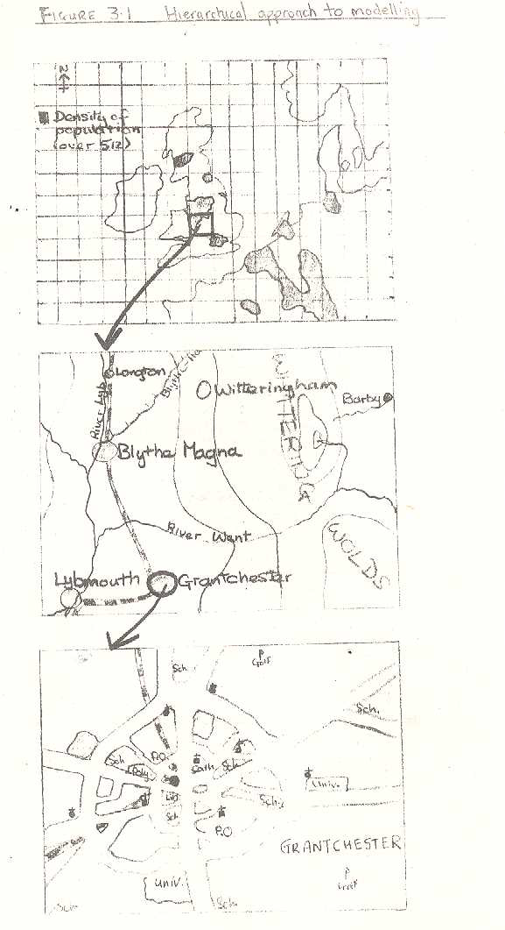
Hierarchical Approach to Modelling

Slide 7
MODELING PHYSICALPROCESSES
Scribbled diagram
may be useful aid to thinking
unlikely to be suitable for conveying ideas to the general public.
English Narrative
Sufficient in some instances but
in other circumstances a specialized diagram with standard symbols or mathematical equation may be a more appropriate model.

Slide 8
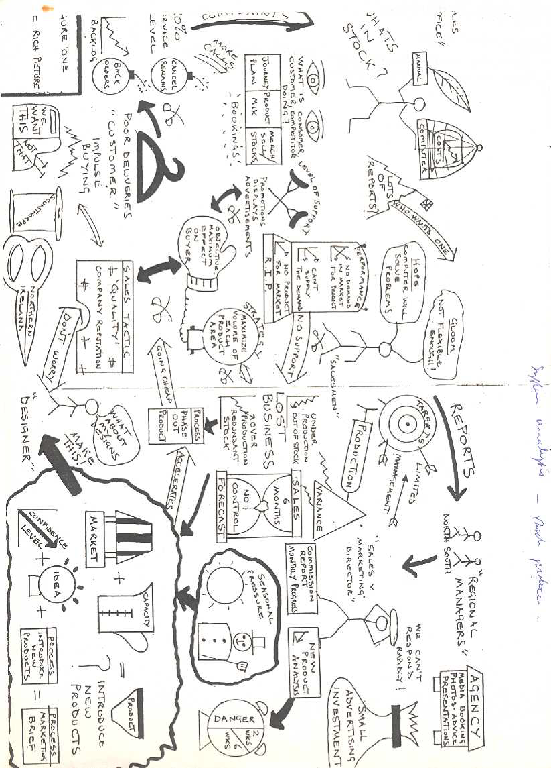
A SAMPLE SCRIBBLED DIAGRAM/ RICH PICTURE

Slide 9
THE ANALYST TOUR
The observation and discussion held on this tour
permits the construction of a model of the physical processes which takes place in the area of study.
This model
aids the analyst’s understanding of the work processes
fixes certain physical constraints to the subsequent design.
provides useful method of communication for those unfamiliar with the system, and
acts as a focus for otherwise abstract discussion with current employees of the company.
In such discussion, misunderstandings or omissions may be identified with the model amended.
No standard method of modeling the physical resources- a rough sketch, scale diagram, narrative, pictures and named systems are all appropriate;

Slide 10
KNITWEAR COMPANY
Manufactures jumpers etc for sale to large chain stores. Process involves
knitting a long roll of the ordered fabric
Fabric then dyed, cleaned and otherwise transformed into a suitable finished state.
Roll of fabric is cut out and sewn to make the finished article.
Thus there are three (3) main processes – knitting, finishing & dyeing, make up.

Slide 11
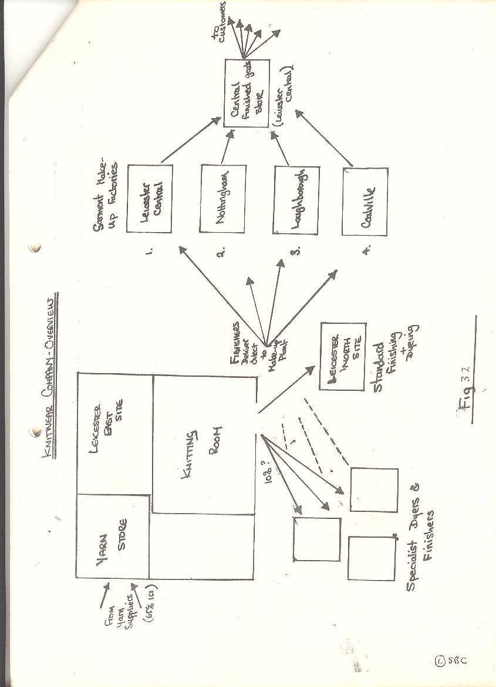
OVERVIEW OF KNITWEAR COMPANY

Slide 12
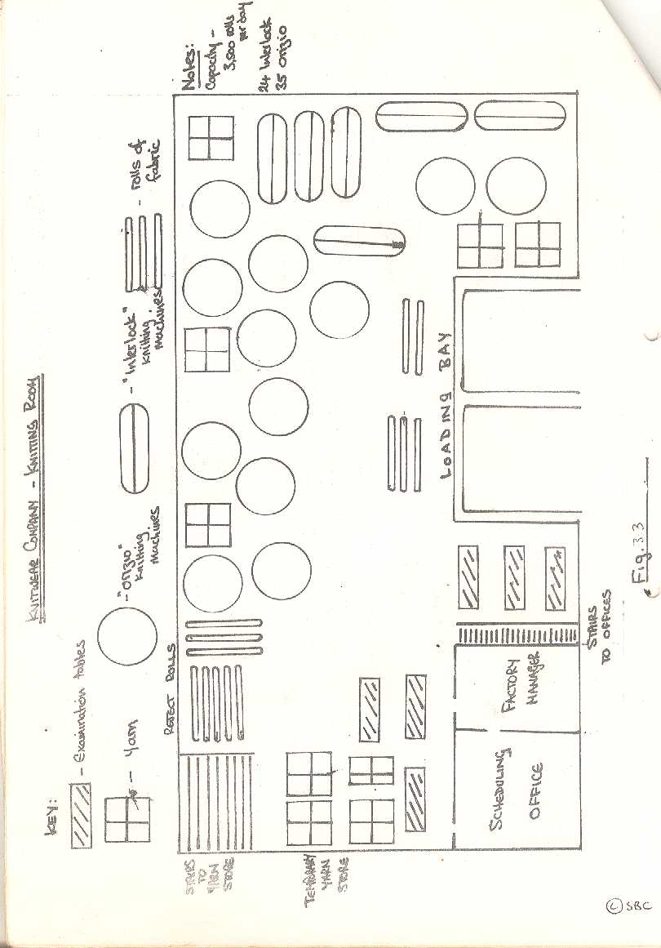
KNITTING ROOM

Slide 13
The diagrams
The 2 diagrams orientate the analyst and provide prompts for more detailed models.
In the first diagram the following are identified:
the functional boundaries – yarn store, knitting processes, dispatches, fabric finishing processes, 3 finishers
the physical boundaries and
the logical boundaries (which will help partition the system into manageable bits)
The 2nd diagram prompts a no. of questions including:
How large is the temporary yarn store?
How long do reject roll remains?
How many are there at any one time?
How close are machines to each other? Is it a problem?
What is the significant of the Interlock machine?
Answering these question enable the analyst to understand the operations of the company and see where the system boundaries exist or may be imposed

Slide 14
THE MESSAGE SYSTEM
Formal Messages
These are documents such as delivery notes, requisitions and invoices, which represent the physical movements of goods.
Easier to discover or investigate.
Informal Messages
Usually between people in the form of conversations, telephone calls or any other medium, which permits information to be shared.
They are difficult to find as a result special effort should be made to discover these flow.
Are very important and sometimes permit an organization to survive in spite of its formal system.
It flows mirror the real information requirements and communication needs of an organization.
They are developed because the formal flow has failed to satisfy that need.

Slide 15
MODELING MESSAGES
The Physical Models give the analyst a broad understanding of the various parts of the system and how they unite together.
The knowledge is vital but that alone is too superficial to form bases for the design of a new system.
To provide an insight into the detailed phases of analyses and design, we look at two diagrammatically models - DFD and flowchart
These two conventions (DFD and Flowchart) overlap.
Use the most appropriate technique from time to time..

Slide 16
SYMBOLS FOR DFD
DFD shows the flow of data not of control and only 4 symbols are used.
Named arrow line Order a data path or flow
A circle or bubble a process
A diagonal line a data depot / file
or open rectangle
A box a source or sink
Check
CUSTOMER

Slide 17
DRAWING DFD
Don’t worry about details
Start with an obvious input from a source or output to a sink and concentrate on the data flows.
Place a circle where a process is required to transform one flow into another.
For all data outputs, consider whether you have enough data flowing into the process to perform the stated transformation and to produce the output.
The first DFD drawn is bound to be wrong. Start again and modify until you are satisfied.

Slide 18
DATAFLOW DIAGRAM
As an exploratory tool
use of DFD is in the early stage of the analysis to help identifying useful facts.
Use as an aid analysis for fact finding etc.
Use for refinement of the model and identification of problems and causes to build a picture of the system to be design.
As a basic for design
Provides a more detailed and a good basis for the design of an impressed system.

Slide 19
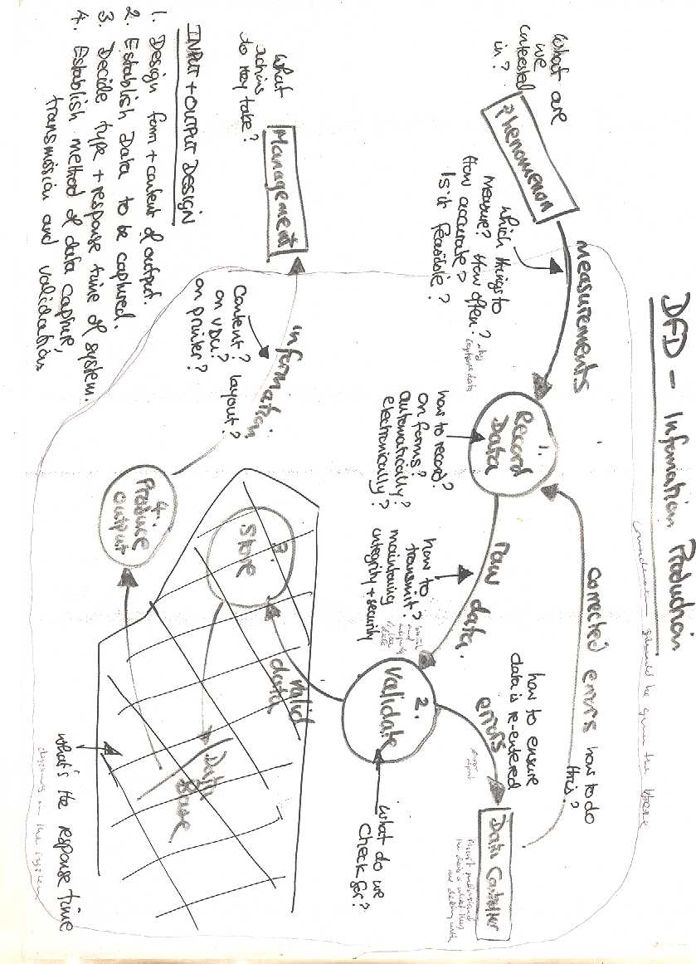
Example on Production

Slide 20
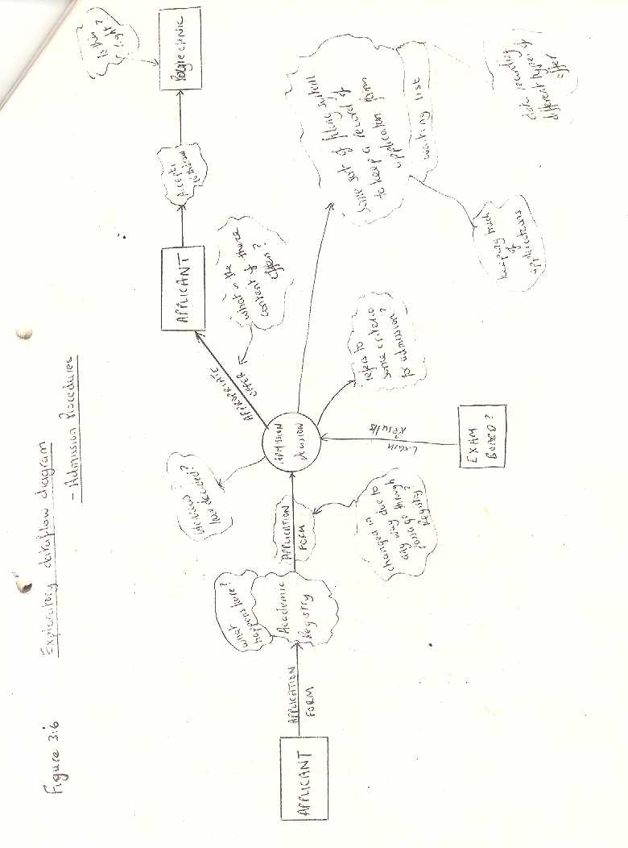
Exploratory DFD - Admission

Slide 21
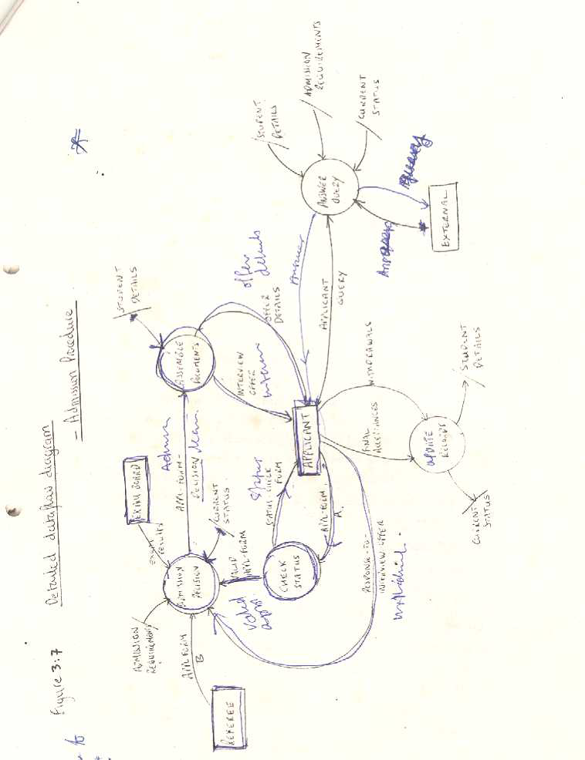
Detailed DFD –Admission Procedure

Slide 22
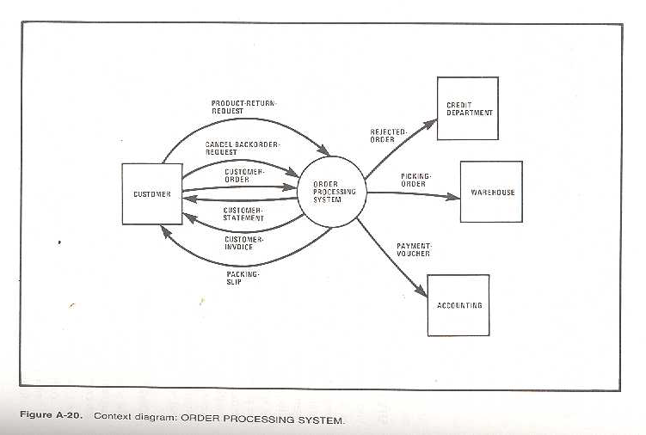
Order Processing System

Slide 23
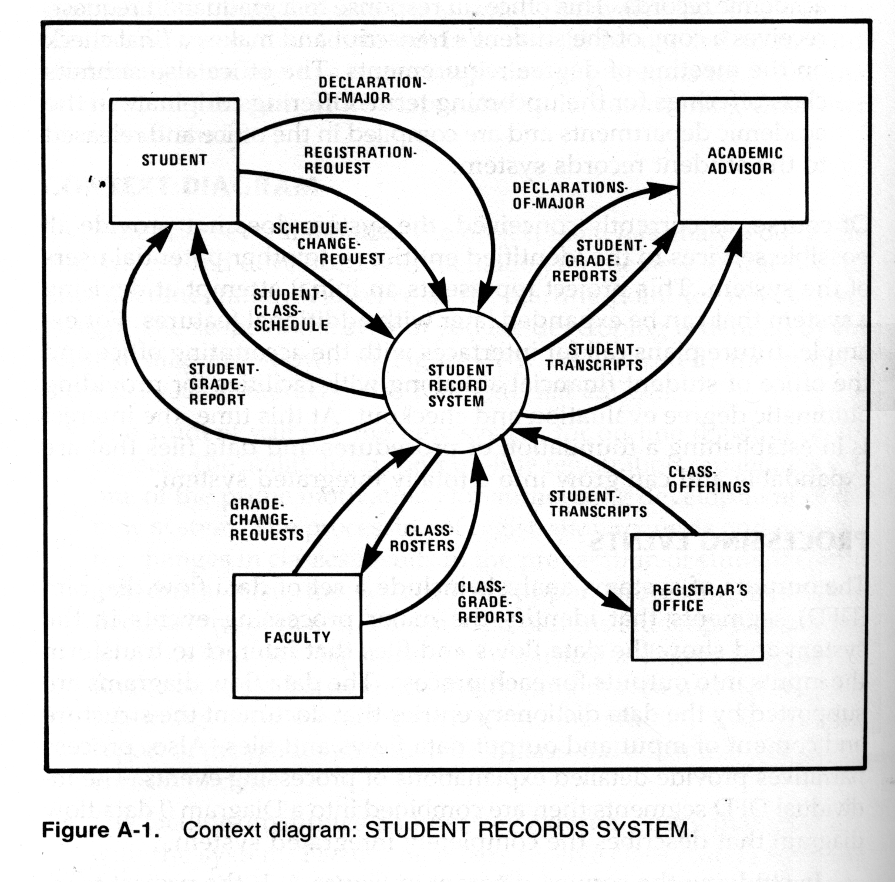
DFD – Student Record System

Slide 24
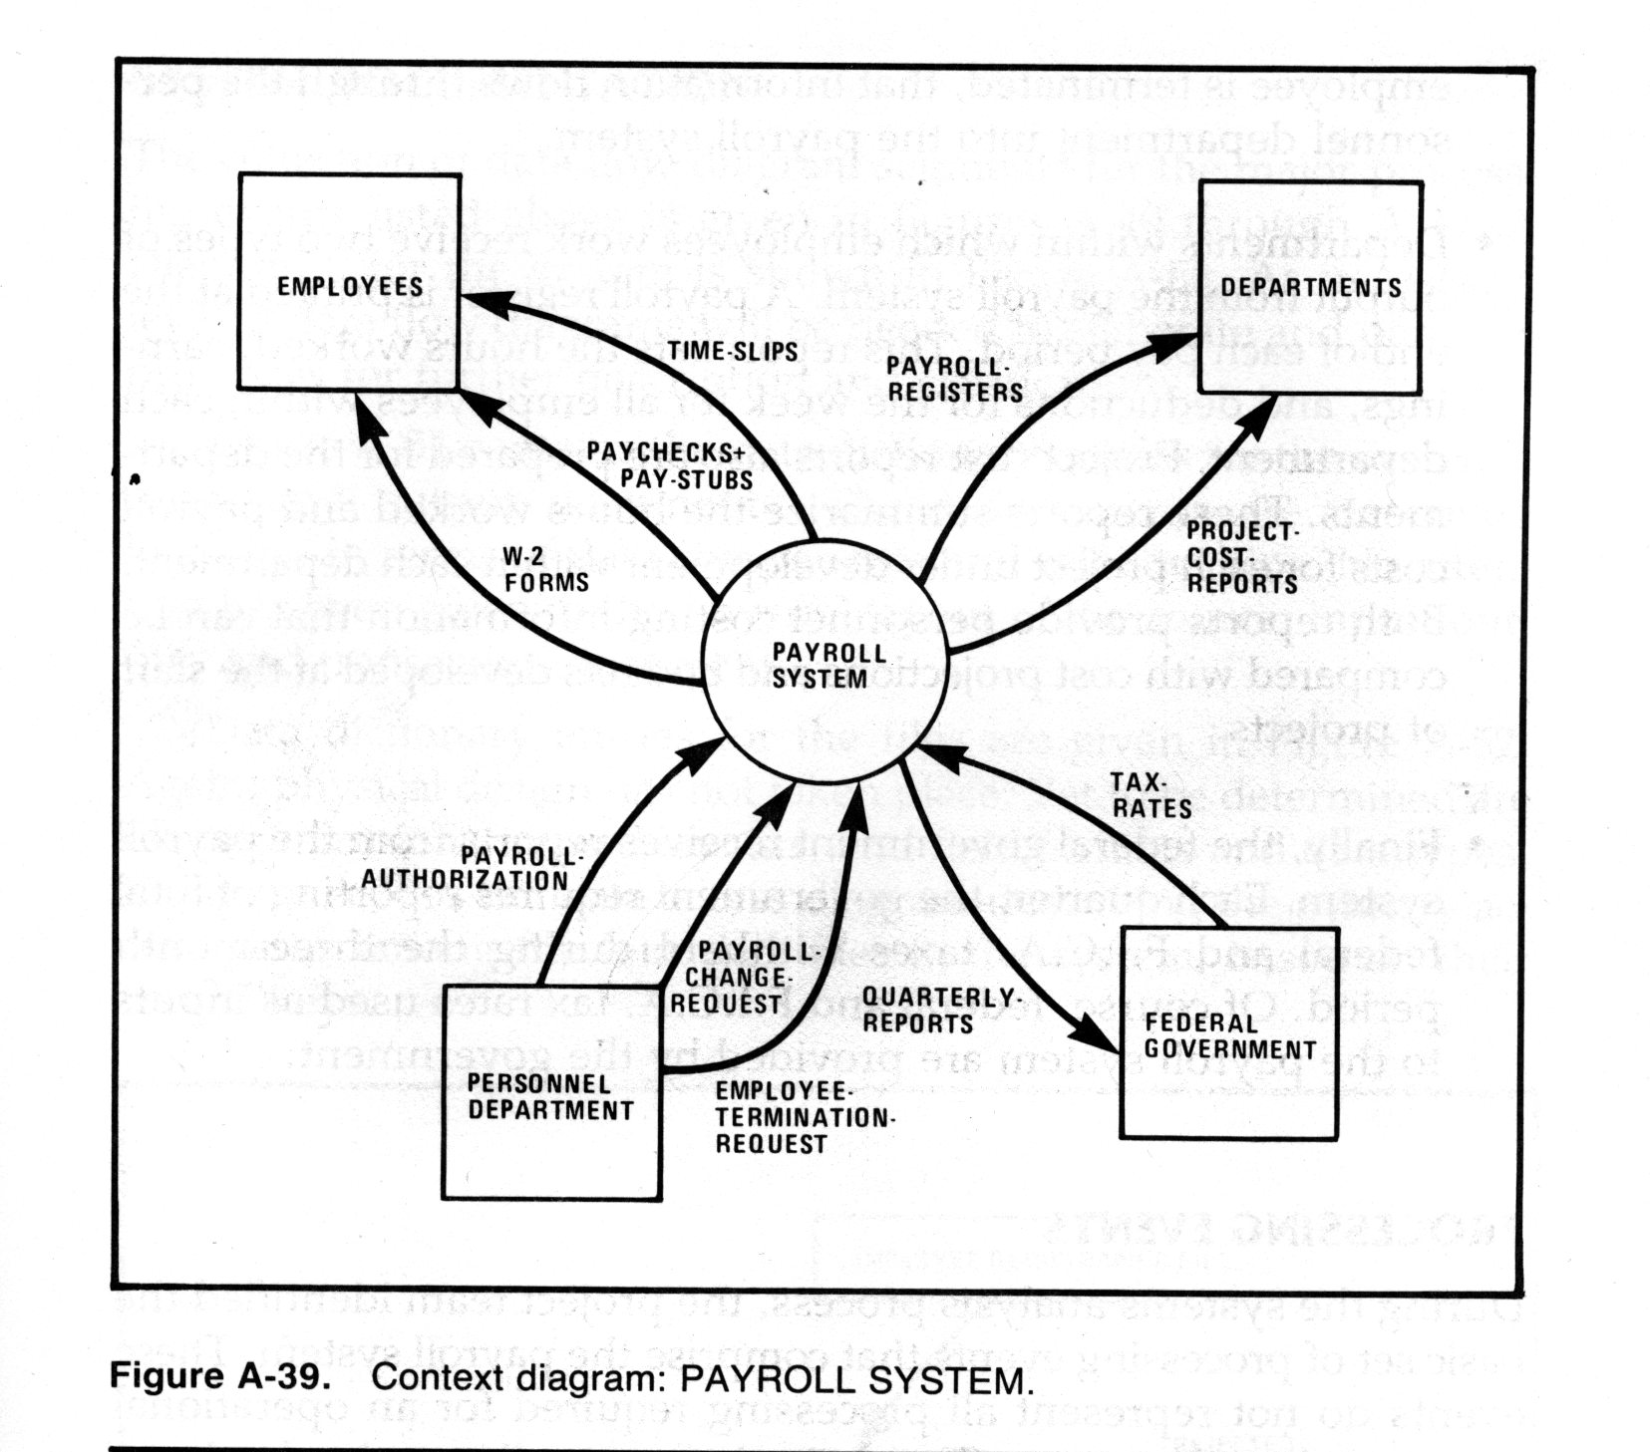
DFD – Payroll System

Slide 25
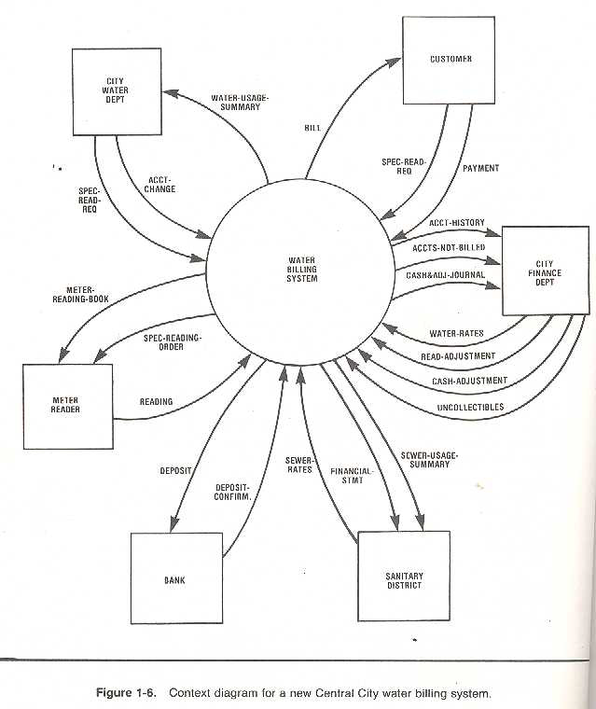
DFD - Water Billing System

Slide 26
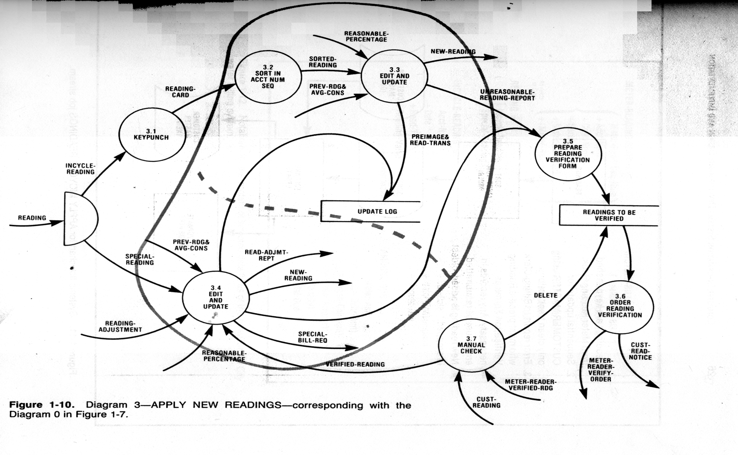
DFD – expanded version

Slide 27
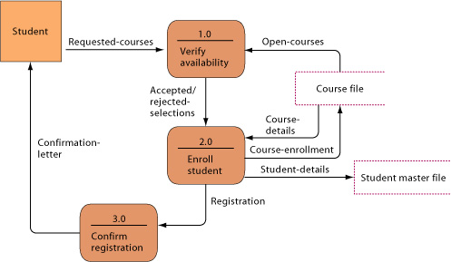
Another form of Data flow diagram
Data flow diagram for mail-in university registration system The system has three processes: Verify availability (1.0), Enroll student (2.0), and Confirm registration (3.0). The name and content of each of the data flows appear adjacent to each arrow. There is one external entity in this system: the student. There are two data stores: the student master file and the course file.

Slide 28
FLOWCHART
This is another diagrammatic aid to understanding and communication.
They cover similar grounds to DFD in some respect.
Flowchart permits a slightly different angle and focus which expose aspects of the system which were not apparent or appear insignificant in the dataflow diagrams.
It uses symbols from the NCC Standards (N.C.C 1969).
This standard defines procedures for documenting and modelling computer and clerical systems.

Slide 29
FLOWCHART SYMBOLS
The following symbols are used will be used on the course but there are many more symbols.
Process Input/Output
Decision box
Report Connector

Slide 30
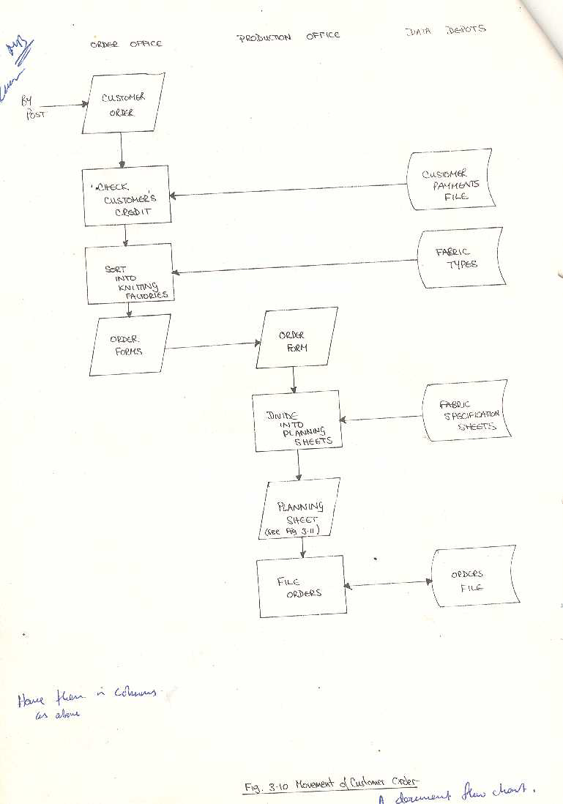
FLOWCHART – MOVEMENT OF CUSTOMER ORDER

Slide 31
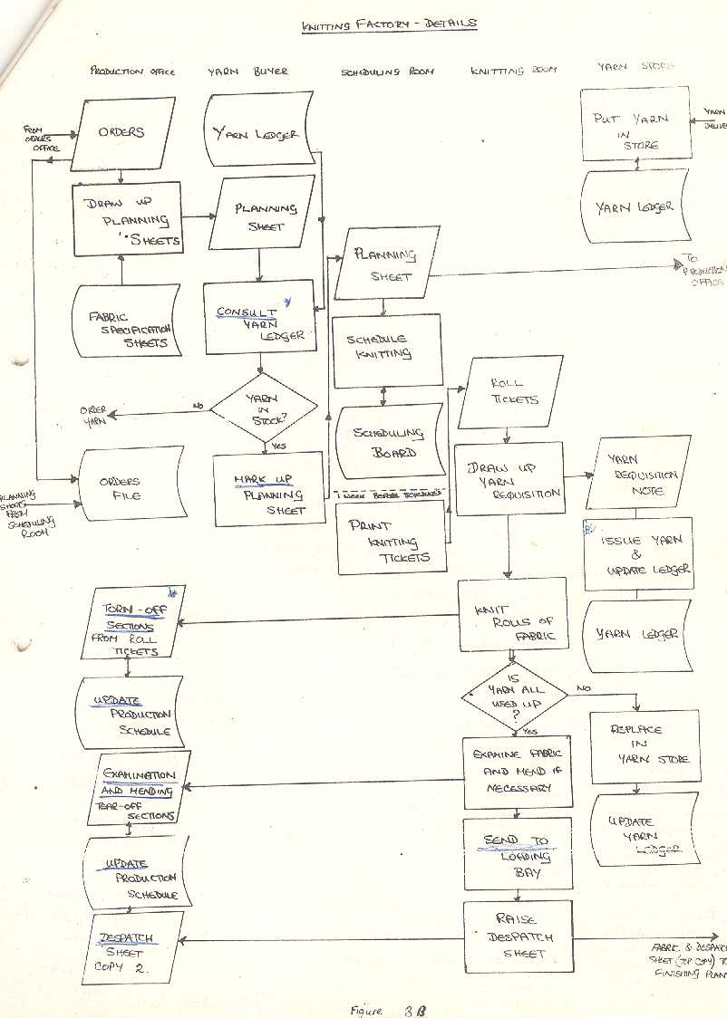
FLOWCHART – KNITTING PROCESS

Slide 32
DFD VS FLOWCHART
Flowcharting notations and DFD overlaps.
Which one to use is largely subjective and therefore adopt the one you feel happier with.
Some subjective comments
provide insight into the system
DFD is ideal due to simple notation
It is also self checking & promote creativity
Flowchart more cumbersome
communicate facts and ideas about the system
Flowchart better for IT personnel & DFD for users
Flowchart is more free-standing unlike DFD

Slide 33
DECISION TABLES
It is a method of defining in compact manner, the actions to be taken when certain specified conditions are fulfilled.
It is a means of describing the task to be carried out in an information system without specifying precisely how those tasks are implemented.
A decision table is essentially made up of four (4) quadrants, created by two double lines which intersect at right angles as depicted
Condition Condition Entry (Rules)
Action Action Entry
we shall limit our studies with the limited entry table

Slide 34
LIMITED ENTRY DECISION TABLE
With a limited entry table, all conditions test and outcomes are either Yes or No. That is, they are Boolean.
The entry portion of this table is marked only if a particular rule satisfies the condition or requires the action stated.
Convention dictates that only 3 symbols are use:
“Y” for YES if the condition is satisfied.
“N” for NO if it is not and
dash ‘-‘ if the condition is not pertinent (irrelevant)
Similarly only two symbols are allowed in the action entry portion.
These are “X” if the action is to be executed and
A blank if it is not.

Slide 35
TERMS USED IN DECISION TABLE
RULE: A correspondence between condition set and action sets in limited entry table.
R=2 ^{c} where C is the number of conditions.
OVERLAP: There is an overlap when two or more conditions have one or more rule in common.
REDUNDANCY: Two rules are said to be redundant if they have the same set but condition sets overlap.
ELSE RULE: Covers all cases not dealt with by the specified rule.
DON’T CARE: Each hyphen or a dash is called a DON’T CARE. In limited entry table each ‘-‘ means that two rules have been combined to make one rule.
Two rules are said to be AMBIGUOUS if they have the same condition but different action set.

Slide 36
CONSTRUCTING A DECISION TABLE
Identify all conditions and write them down
Identify all actions and write them down in their correct order.
Identify all probably combinations and create a rule for each combination showing appropriate actions.
Consolidate the table.

Slide 37
SAMPLE DECISION TABLE
Conditions
Applicant Male? | Y | Y | Y | Y | N | N | N | N
Qualified? | Y | Y | N | N | Y | Y | N | N
Internal? | Y | N | Y | N | Y | N | Y | N
Actions
Use white | X | X
Use Red |  |  |  |  | X | X | X | X
Use Blue |  |  | X
Take IQ test |  |  |  | X

Slide 38
USE OF DECISION TABLE
The different ways in which decisions tables used include
As a description of clerical procedures
As a description of required program logic in a program specification.
As a means of analysis of procedures to check for thoroughly feasibility and alternatives.
As a means for standard documentation.
As a means of unambiguous communication between people knowledgeable in their use

Slide 39
ADVANTAGES & DISADVANTAGES
ADVANTAGES
It is possible to check that all test combinations have been considered.
Table users need not necessarily understand computers.
They use standard format.
Under certain conditions, programs may be coded directly from the table.
DISADVANTAGES
Actions before conditions are not taken care of.
Tables become complex especially in the extended entry table when the numbers of rules are many.

